Slide 1
STARBUCKS STOCK PITCH
THE CASH COWS

Slide 2
Timeline
About Starbucks
Statistics
Recent Trends
Indications

Slide 3
About Starbucks
01
Global Leader in Food / Beverage Industry
02
Own close to 40k stores worldwide
03
Rewards Program / Brand Loyalty

Slide 4

Starbucks Stats
01
Market Cap: $108.49 Billion
02
P/E Ratio: 26.82
03
Current Stock Price: $95.55
All time high: $117.32 July 26, 2021
Revenue peaked in 2023 at 29.5 Billion USD and had highest brand value of any global restaurant chain at almost 61 Billion USD. It also had the highest sales.
2nd Quarter of 2024, Starbucks had their first revenue decline since COVID. It was influenced greatly by its perceived stance on the Israel-Hamas War.
Starbucks has introduced more online-ordering options and the Starbucks app to position them for future global growth.

Slide 5
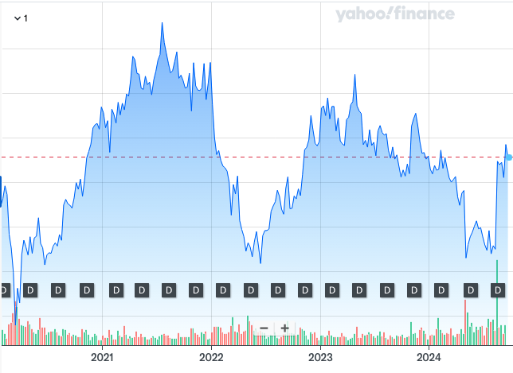
Starbucks Stats
Sector: Consumer Cyclical
Industry: Restaurants
Current Price: $95.55
Beta: 0.96
Dividend Yield: 2.37%
EPS: 3.57 PEG Ratio: 1.63

Slide 6
Recent Trends
Post-covid, Starbucks had the first revenue decline due to the conflict in Gaza, and the mass boycott of the company.
This led to a 2% dip in stock price in the final quarter of 2023.
Due to the boycott, sales fell and the previous CEO resigned, and due to this the Chipotle CEO took over.
The new Chipotle CEO, Brian Niccol, was chosen due to the growth and innovation that Chipotle underwent during Niccol’s time.

Slide 7
Good Indicators
Investments in Employee Wages, Cold Beverage Bar Technology, On-Demand Brewers
Innovations in Beverages - cold brews, vegan options, energy drinks
Data-driven Structure to target specific customer groups
Has an edge over smaller competitors

Slide 8
Thank you
ANY QUESTIONS

